Slide 1

YESHWANTRAO CHAVAN COLLEGE OF ENGINEERING
Department of Computer Science and Engineering
Speak2Summarize : Daily Recap
Group No : 28
Team Members :
Hemanshu Waghmare
Rishabh Jain
Dhruv Dalvi
Sanket Asole
Yuvraj Chavan
Under the Guidance of
Prof. Chanchla Tripathi
Date: 28 Sept 2024
Prof. Chanchla Tripathi Department of Computer Science and Engineering | [ Co-Guide Name (if any) ] [Department of co-guide/ Industry Name/ Institute Name]

Slide 2
CONTENTS
PROBLEM STATEMENT
ABSTRACT
OBJECTIVES
LITERATURE REVIEW AND PATENT SEARCH
METHODOLOGY
DATASET TO BE USED
PLAN OF PROJECT
WORK CARRIED OUT TILL DATE
SOCIAL UTILITY
CONCLUSION
REFRENCES

Slide 3
PROBLEM STATEMENT
Many people find it challenging to remember daily tasks and important details, leading to decreased productivity, missed responsibilities, and heightened stress. An effective solution is crucial for improving task management and memory recall.

Slide 4
ABSTRACT
We present a method that takes audio as an input and generates a written or text summary of the same as an output. created the text summary using text summarizing methods. This proposed method is implemented in machine learning. In today's information-rich environment, finding relevant content quickly can be challenging. Automatic document summarization, using natural language processing, helps extract key information from extensive texts. Text summarization techniques, whether extraction-based or abstraction-based, aim to condense lengthy content into concise summaries. Our product, Speak2Summarize, addresses this common challenge by providing users with clear and concise text summaries of their interactions and daily meetings with given timestamps.

Slide 5
OBJECTIVES
Aim :- The aim of the project Speak2Summarize is to enhance individual productivity by leveraging advanced technologies in Machine Learning and Natural Language Processing (NLP) to facilitate effective memory recall and optimized task management.
1) Memory recall and Optimized task management.
2) Provide concise text summaries of their Daily interactions and meetings with given timestamps.
3) A product, Speak2Summarize addresses this common challenge by Machine Learning and Natural Language Processing.

Slide 6
LITERATURE REVIEW
Sr. No. | Title of the paper with year | Conference/ journal name | Methodology Used | Datasets Used | Authors Claim | Limitations/ Scope | Our Findings/Research Gaps
1) | An Approach for Audio/Text Summary Generation from Webinars/Online Meetings - 2021 | Computational Intelligence and Communication Networks | Google Speech api + pydub | 10 Youtube videos clips | Better transcripts are generated when background have less noise | Limited to data with less background noise. | Text summary, audio summary, video to audio conversion. The proposed scheme is evaluated using short videos acquired from Youtube
2) | AUDIO SUMMARIZATION FOR PODCASTS -2021 | 29th European Signal Processing Conference (EUSIPCO). | AWS transcribe, spaCy, PreSumm model (BERT) | 309 different podcast episodes (309 hrs) | Best performance (ROUGE-L F-score of 0.64) in comparison with the baseline method (ROUGE-L F-score of 0.52). | Additional techniques such as speech speaker diarization could also be beneficial as podcasts generally have multiple speakers. | Converting podcast audio into test using AWS transcribe. A well-known ASR tool, PreSumm model.

Slide 7
Sr. No. | Title of the paper with year | Conference/ journal name | Methodology Used | Datasets Used | Authors Claim | Limitations/ Scope | Our Findings/Research Gaps
3) | Visual Audio Summarization Based on NLP Models - 2022 | 1st International Conference on Computational Science and Technology (ICCST). | Youtube-transcript-api, BART model for text summarization | Video with and without subtitle | Long texts are condensed into brief summaries while maintaining the essential information and overall sense by using BART model. | Future scope includes the issue of the complexity of the Indian language and make an effort to create organic summaries. | Utilizing Hugging-face’s BART model for handling long range dependencies in sequence to sequence task. Presents deeper concept of NLP which is not required.
4) | Text Summarization using NLP-2024 | International Research Journal of Engineering and Technology (IRJET) | Spacy for dealing with text data, Nltk for tokenization, parsing and classification, Word frequency counting | 100 English Sentences. | ROUGE-1 Score (Unigram Overlap): Recall of 57.95% precision of 38.35% F1- score of 0.4615 ROUGE-L Score (Longest Common Subsequence): A recall of 56.82% precision of 37.59% F1-score of 0.4525 | Future scope includes summarization of articles and texts without losing most of the meaning. | It covers extractive and abstractive summarization techniques, focusing on sentence selection and sentence scoring to retain key information.

Slide 8
Sr. No. | Title of the paper with year | Conference/ journal name | Methodology Used | Datasets Used | Authors Claim | Limitations/ Scope | Our Findings/Research Gaps
5) | Implementation of NLP based automatic text summarization using spacy- 2022 | International Journal of Health Sciences. | Implementation of spacy library for text summarization | Random English sentences | Spacy provides an effective way of preprocessing the data | Limitation of difficult task of abstract summarization (difficult to exactly summarize the same meaning) | The implementation ranks sentences by word frequency and importance, effectively summarizing the extracted text.
6) | A survey on audio analysis: Text characterization and summarization -2024 | World Journal of Advanced Research and Reviews | Generative Adversarial Networks (GANs), Functionality of LSTM, BART model, Google speech to text api | - | Combined use of BART model and Google speech to text api can handle massive amount of data | Each technology has its own pros and cons and selection of technology depends on current problem | Comparative study of various algorithms such as Rule based systems, HMM, GANs, LSTM, RNN, BART model, Google speech to test api

Slide 9
Sr. No | Title of the paper with year | Conference/ journal name | Methodology Used | Datasets Used | Authors Claim | Limitations/ Scope | Our Findings/Research Gaps
7) | Audio Transcription and Summarization System using Cloud Computing and Artificial Intelligence- 2023 | International Journal on Recent and Innovation Trends in Computing and Communication | AWS Transcribe with OpenAI's ChatGPT | Virtual meeting data from various platform such as Google Meet, Microsoft Teams of various accents and speaking styles | AWS Transcribe with OpenAI's ChatGPT gives summaries with High accuracy | Limited to use of external apis. APIs with high accuracy are paid services | Evaluate various ASR services (Amazon Transcribe, Google Cloud Speech-to-Text, etc.) for accuracy, scalability, and features. Integration with ChatGPT: Uses GPT-3 to generate meeting summaries from transcribed text.
8) | AUDIO DATA SUMMARIZATION SYSTEM USING NATURAL LANGUAGE PROCESSING- 2019 | International Research Journal of Engineering and Technology (IRJET) | NLTK library, Google speech to text api | .wav file recordings from mobile phone microphone. | Efficiency of speech to text and summarization depends on clarity of audio file. | Limitation of use of less noisy data for efficient summarization | The system efficiently converts speech audio to text, summarizes it using NLP techniques like tokenization and sentence scoring, and provides both text and audio summaries of the content.

Slide 10
Sr. No. | Title of the paper with year | Conference/ journal name | Methodology Used | Datasets Used | Authors Claim | Limitations/ Scope | Our Findings/Research Gaps
9) | SPEECH RECOGNITION WITH DEEP RECURRENT NEURAL NETWORKS- 2013 | IEEE International Conference on Acoustics, Speech and Signal Processing | RNN, Connectionist Temporal Classification, RNN transducer, Decoding and Regularisation | TIMIT Corpus | The advantage of deep networks is immediately obvious, with the error rate for CTC dropping from 23.9% to 18.4% | An obvious next step is to ex- tend the system to large vocabulary speech recognition. | Gives insights into how deep RNN are created for speech to text model and how various combination of layers affect the accuracy and errors
10) | A Review on Sentiment Analysis of Text, Image and Audio Data - 2021 | 5th International Conference on Computing Methodologies and Communication (ICCMC) | Naive Bayes, SVM and Maximum Entropy, VADER for text RNN-T model, Bi-LSTM, Attention model and SoftMax and HMM, Naive Bayes and SVM for audio data | Twitter Dataset | Possible to achieve better results by combining different modalities such as visual and textual as compared to using one at a time. | approaches rely completely on lexicons and if a particular word cannot be found in the dictionary then it cannot classify that word. | Presents a workflow for classification of audio data. Also, compare multiple models for better selection according to need.

Slide 11
Patent
Title : MULTI-MODAL VOICE RECOGNITION SYSTEM AND METHOD FOR CONVERSATION SUMMARIZATION
Application Number : 18/540,594
Inventors: Jeom Ja KANG (Daejeon), Kiyoung PARK (Daejeon), Hwajeon SONG (Daejeon)
Summary and Limitations : summarizing conversations by focusing on key words and using multimodal inputs, but there are clear limitations regarding bias, real-time performance, over-simplification, and context sensitivity. Balancing accuracy with these practical challenges

Slide 12
METHODOLOGY

Slide 13
METHODOLOGY
Speech-to-text
Data Preprocessing | Model Training | Decoding and Evaluation
Dataset Collection: Gather a dataset with audio for the Model Training task. (Common voices) Audio Segmentation: Split the audio into individual speaker segments. (Pyannote.audio) Feature Extraction: Convert audio segments into numerical features. ( Pydub, Numpy) | A. Sequence to Sequence Models: Architectures like Recurrent Neural Networks (RNNs) or Transformers are commonly used for speech recognition ( ASR ). Whisper (OpenAI) Wav2Vec 2.0 (Facebook) DeepSpeech (Mozilla) | Loss Function: Use a suitable loss function like Connectionist Temporal Classification (CTC) to handle variable-length input and output sequences. Beam Search: Use beam search to find the most probable text sequence given the model's output probabilities. Metrics: Evaluate the model using metrics like Word Error Rate (WER) or Character Error Rate (CER).

Slide 14
METHODOLOGY
Text-to-summary
Text Preprocessing | Feature Extraction | Summarization Model | Evaluation
Tokenization: Breaking text into individual words or subwords. Stop word removal: Eliminating common words with little semantic value. Stemming or lemmat-ization: Reducing words to their root form. | Generate numerical represe-ntations of text using techniques like TF-IDF, word embeddings (Word2Vec, GloVe), or contextual embeddings (BERT). Text Normalization: Clean and standardize the corresponding text transcripts (lowercase, punctuation handling, etc.). | Extractive Summarization: Identify and extract the most important sentences from the text. Techniques include TextRank, Latent Semantic Analysis (LSA), or supervised learning models. Abstractive Summarization: Generate new text that captures the essential information of the original text. Employ sequence-to-sequence models like recurrent neural networks (RNNs), long short-term memory (LSTM), or transformer-based models (e.g., BART, T5). | Assess the quality of the generated summaries using metrics

Slide 15
DESCRIPTION OF DATASET TO BE USED
What’s inside the Common Voice dataset?
Each entry in the dataset consists of a unique MP3 and corresponding text file. Many of the 32,585 recorded hours in the dataset also include demographic metadata like age, sex, and accent that can help train the accuracy of speech recognition engines.
The dataset currently consists of 21,594 validated hours in 131 languages and we are using 44000 audios from dataset.
Link- https://commonvoice.mozilla.org/en/datasets

Slide 16
PLAN OF PROJECT
Module 1: Audio Data Preprocessing
Collect and preprocess the dataset.
Classification of speakers using speech diarization.
Segmentation of the data.
Module 2: Speech to Text (STT)
Implement STT model for the dataset.
Model may use RNN/transformer.
Test the accuracy using WER(word error rate), CER(character error rate).
Add post processing components such as annotations.

Slide 17
PLAN OF PROJECT
Module 3: Text Preparation for Summarization
Prepare and tokenize the text data.
Remove stopwords.
Perform necessary data cleaning and formatting.
Module 4: Text Summarization
Compile the cleaned data using RNN/transformer layers.
Test and validate the summarization results.
Module 5: Hardware Implementation
A device consisting of microphone and memory card for recording.

Slide 18
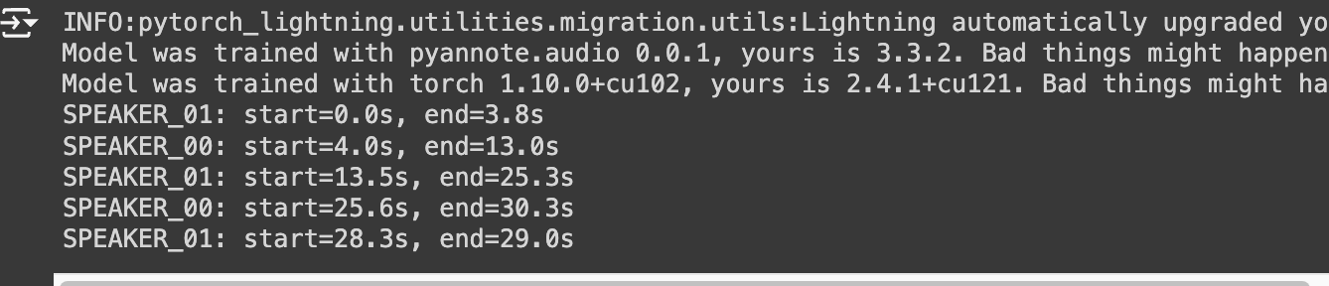
WORK CARRIED OUT TILL DATE
Performed Diarization on Audio for dentifying and distinguishing between multiple speakers in an audio file.

Slide 19
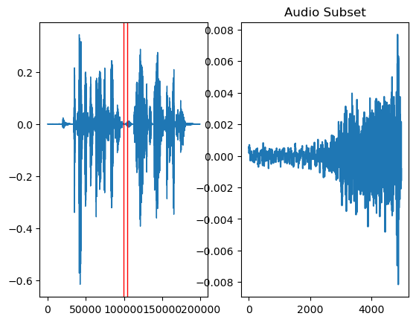
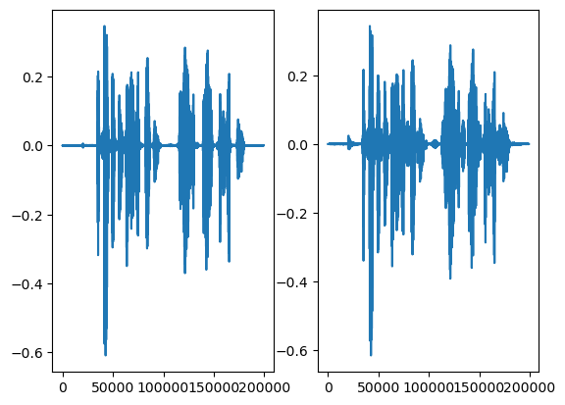
RESULT AND DISCUSSION
New vs Old Sample File
Gathered dataset with audio’s and performed Normalization and Noise Cancellation
Performed conversion of audio to numerical segments.

Slide 20
SOCIAL UTILITY
Productivity Enhancement
For professionals, the system could summarize important points from meetings or conversations, helping users keep track of key decisions, action items, and follow-ups.
Personal Journal
Individuals could use the system as an audio journal, allowing them to reflect on their day’s events. At the end of the day, they receive a concise summary of key conversations, thoughts, or important points captured.
Documentation/MOM
The system could aid in settings where a day’s worth of audio recordings, such as in interviews, need to be summarized and stored as documentation for future reference.

Slide 21
CONCLUSION
The proposed solution, Speak2Summarize, addresses the common challenge of memory recall and task management using advanced Machine Learning and Natural Language Processing techniques. The structured approach of the project ensures seamless integration of audio processing, speech-to-text conversion, and text summarization to provide users with efficient and concise summaries of their daily interactions.

Slide 22
REFERENCES
[1] Nitesh Bharti, Shahab Nadeem Hashmi, V. M. Manikandan, “An Approach for Audio/Text Summary Generation from Webinars/Online Meetings” in 2021 13th International Conference on Computational Intelligence and Communication Networks. Available: https://ieeexplore.ieee.org/document/9574684
[2] Aneesh Vartakavi, Amanmeet Garg, and Zafar Rafii, “AUDIO SUMMARIZATION FOR PODCASTS” in 2021 29th European Signal Processing Conference (EUSIPCO). Available: https://ieeexplore.ieee.org/document/9615948
[3] Dr.B.Latha, B.Nivedha, Y.Ranjanaa, “Visual Audio Summarization Based on NLP Models” in 2022 1st International Conference on Computational Science and Technology (ICCST). Available: https://ieeexplore.ieee.org/document/10040385
[4] B Rajesh, K Nimai Chaitanya, P Tejesh Govardhan, K Krishna Mahesh, B Sudarshan, “Text Summarization using NLP” in 2024 International Research Journal of Engineering and Technology (IRJET). Available: https://www.irjet.net/archives/V11/i3/IRJET-V11I392.pdf
[5] Nayana Cholanayakanahalli Prakash, Achyutha Pasad N, Jagadeesh Bettakote Nagaraj, Piyush Kumar Pareek, “Implementation of NLP based automatic text summarization using spacy”, in 2022 International Journal of Health Sciences. Available: https://www.researchgate.net/publication/362581063_Implementation_of_NLP_based_automatic_text_summarization_using_spacy

Slide 23
REFERENCES
[6] Maheshwar Reddy V, Deepika K, Adithya Surya Prakash K and Sanathan M, “A survey on audio analysis: Text characterization and summarization ”, in 2024 World Journal of Advanced Research and Reviews. Available: https://wjarr.com/content/survey-audio-analysis-text-characterization-and-summarization
[7] Kaushal Rajendra Khonde, Dr. Jaimeel Shah, Dr. Pratik Patel, “Audio Transcription and Summarization System using Cloud Computing and Artificial Intelligence” in 2023 International Journal on Recent and Innovation Trends in Computing and Communication. Available: https://ijritcc.org/index.php/ijritcc/article/view/8606
[8] Pravin Khandare, Sanket Gaikwad, Aditya Kukade, Rohit Panicker, Swaraj Thamke,“AUDIO DATA SUMMARIZATION SYSTEM USING NATURAL LANGUAGE PROCESSING”, in 2019 International Research Journal of Engineering and Technology (IRJET). Available: https://www.irjet.net/archives/V6/i9/IRJET-V6I957.pdf
[9] Alex Graves, Abdel-rahman Mohamed and Geoffrey Hinton, “ SPEECH RECOGNITION WITH DEEP RECURRENT NEURAL NETWORKS ”, in 2013 Department of Computer Science, University of Toronto. Available: https://arxiv.org/pdf/1303.5778
[10] Dr. Munish Mehta, Kanhav Gupta, Shubhangi Tiwari, Anamika, “A Review on Sentiment Analysis of Text, Image and Audio Data” in 2021 5th International Conference on Computing Methodologies and Communication (ICCMC). Available: https://ieeexplore.ieee.org/document/9418360

